Slide 1
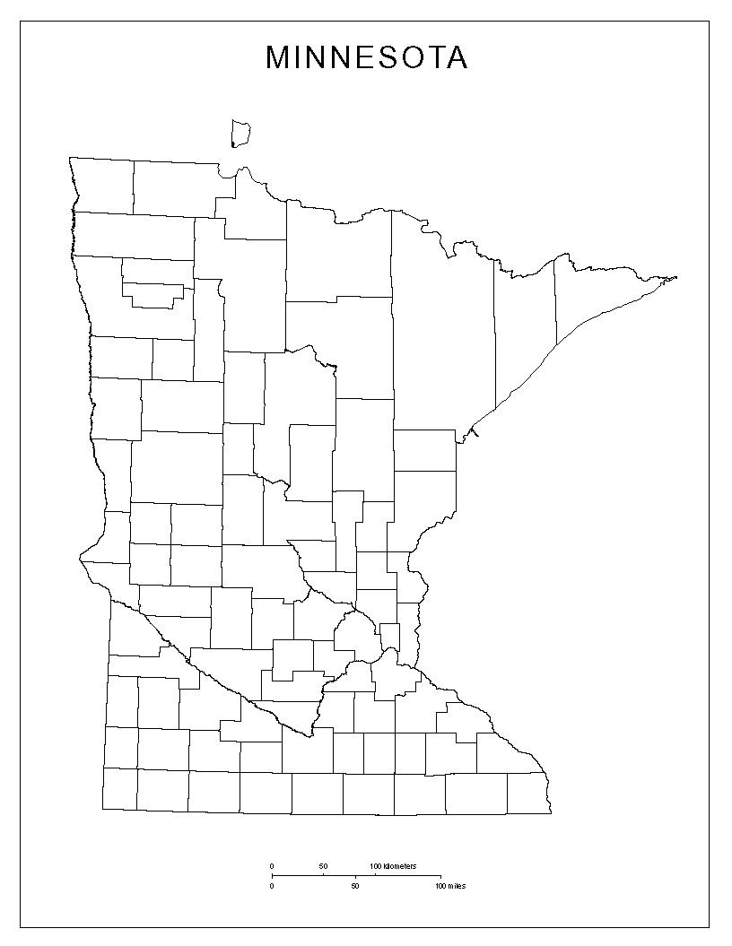
Who am I?

Slide 2
Cass

Slide 3
Who am I?

Slide 4
Pine

Slide 5
Who am I?

Slide 6
Becker

Slide 7
Who am I?

Slide 8
Crow Wing

Slide 9
Who am I?

Slide 10
Benton

Slide 11
Who am I?

Slide 12
Norman

Slide 13
Who am I?

Slide 14
Hubbard

Slide 15
Who am I?

Slide 16
Mille Lacs

Slide 17
Who am I?

Slide 18
Clay

Slide 19
Who am I?

Slide 20
Clearwater

Slide 21
Who am I?

Slide 22
Morrison

Slide 23
Who am I?

Slide 24
Aitkin

Slide 25
Who am I?

Slide 26
Kanabec

Slide 27
Who am I?

Slide 28
Mahnomen

